Slide 1



1
06
Software
Design
z

Slide 2
2
z
Today’s
Lesson
The
Design
Process
The
Design
Model
Specific
Part
Design
Design
Concepts

Slide 3
3
z
Software Design
▪ Software design encompasses the set of principles, concepts,
and practices that lead to the development of a high-quality
system or product.
▪ It allows you to model the system or product that is to be built.
▪ This model can be assessed for quality and improved before code is generated, tests are conducted, and end users become involved in large numbers.

Slide 4
4
z
Software
Design
Architecture
Interface
Components

Slide 5
5
z
Software Design
▪ Software design is applied regardless of the software process
model that is used.
▪ Beginning once software requirements have been analysed and
modelled
▪ It is the last software engineering action within the modelling
activity and sets the stage for construction

Slide 6
6
z
Software
Design
▪ The data/class design transforms class models into design class
realizations and the requisite data structures
▪ The architectural design defines the relationship between major
structural elements of the software, the architectural styles and
design patterns that can be used to achieve the requirements of
the system

Slide 7
7
z
Software Design
▪ The interface design describes how the software communicates
with systems that interoperate with it, and with humans who use
it. An interface implies a flow of information (e.g., data and/or
control) and a specific type of behaviour. for interface design.
▪ The component-level design transforms structural elements of
the software architecture into a procedural description of
software components. Information obtained from the class-
based models, flow models, and behavioural models serve as
the basis for component design.

Slide 8
8
z
The
Essence of Software
Design
▪ The importance
of software design is quality.
▪ Design provides representations of software that can be
assessed for quality.
▪ Design is the only way that you can accurately translate
stakeholder’s requirements into a finished software product or
system.
▪ Software design serves as the foundation for all the software engineering and software support activities that follow.

Slide 9
9
z
The Design Process
▪ Software design is an iterative process through which
requirements are translated into a “blueprint” for constructing the
software.
▪ Initially, the blueprint depicts a holistic view of software. That is,
the design is represented at a high level of abstraction
▪ As design iterations occur, subsequent refinement leads to design representations at much lower levels of abstraction.

Slide 10
10
z
The Design Process
Three characteristics that serve as a guide for the evaluation
of
▪
a good design:
The design must implement all of the requirements contained in the
requirements model
The design must be a readable, understandable guide for those who
generate code and for those who test and subsequently support the
software.
The design should provide a complete picture of the software, addressing the data, functional, and behavioural domains from an implementation perspective
▪
▪

Slide 11
11
z
Design Concepts
Abstraction
Architecture
Modularity
Information
Hiding
Functional
Independence
Refactoring

Slide 12
12
z
The Design Model
Architectural Design
Component-Level Design
User Interface Design

Slide 13
13
z
Architectural
Design
▪ Architectural design represents the structure of data
and
program components that are required to build a computer-
based system.
▪ It looks at the overall organization of the system
▪ The work product is the architectural model

Slide 14
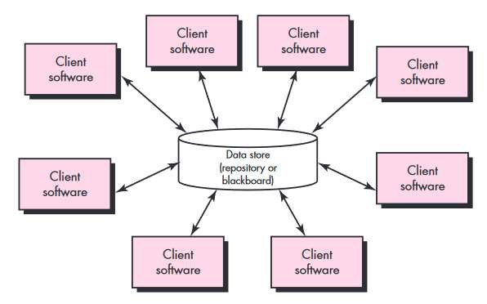
14
z
Some Architectural Styles
Data-centered Architectures

Slide 15
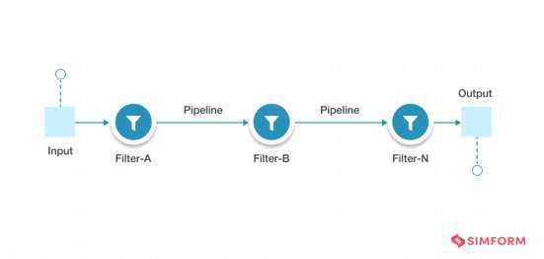
15
z
Some
Architectural Styles
Pipe-Filter Architectures
▪ Best suited for applications that
process data in a stream using web services and can create simple sequences to complex structures.
▪ Eg: Compilers, since each filter performs lexical analysis, parsing, semantic analysis,
and code generation.

Slide 16
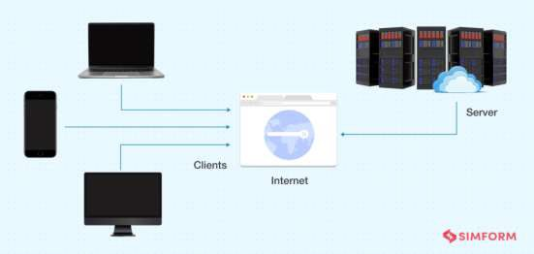
16
z
Some
Architectural Styles
Client-Server
Architectures
▪ Client makes a request
▪ Server responds with
resources
▪ Email is a prominent example of a model that is built using the client-server pattern.

Slide 17
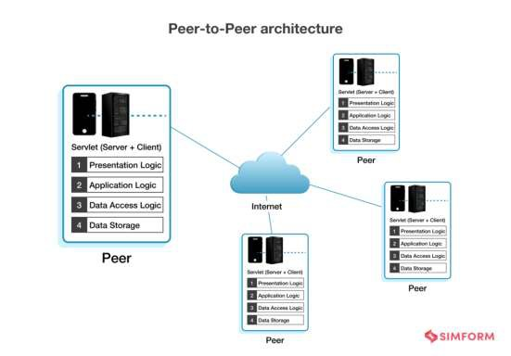
17
z
Some
Architectural Styles
Peer-to-Peer
Architectures
▪ Peer can act as a client
making a request or as a
server responding with
resources
▪ Example would be file- sharing networks like Skype, BitTorrent

Slide 18
18
z
Component Level-Design
▪ A component is a modular building block for computer software
▪ Because components reside within the software architecture,
they must communicate and collaborate with other components
and with entities (e.g., other systems, devices, people) that exist
outside the boundaries of the software

Slide 19
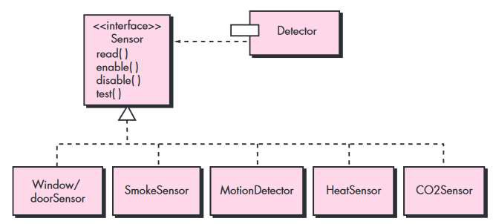
19
z
Basic Component Design Principles
The Open-Closed Principle (OCP)
▪ A module [component] should be open for extension but closed for
modification

Slide 20
20
z
Basic Component Design Principles
The Liskov Substitution Principle (LSP)
▪ Subclasses should be substitutable for their base classes

Slide 21
21
z
Basic Component Design Principles
Dependency Inversion Principle (DIP)
▪ Depend on abstractions. Do not depend on concretions

Slide 22
22
z
Basic Component
Design
Principles
Other Principles
The Interface Segregation Principle (ISP)
• Many client-specific interfaces are better than one general purpose interface
The Release Reuse Equivalency Principle (REP)
• The granule of reuse is the granule of release
The Common Closure Principle (CCP)
• “Classes that change together belong together
The Common Reuse Principle (CRP)
• Classes that aren’t reused together should not be grouped together

Slide 23
23
z
User Interface Design
▪ User interface design creates an effective communication
medium between a human and a computer.
▪ Following a set of interface design principles, design identifies
interface objects and actions and then creates a screen layout
that forms the basis for a user interface prototype
▪ User scenarios are created and screen layouts are generated
▪ An interface prototype is developed and modified in an iterative fashion

Slide 24
24
z
User Interface
Guidelines
Reduce the
user’s
memory
load
Place the user in control
Make the interface consistent
Golden
Rules

Slide 25
25
z
User Interface
Guidelines
Place the user in control
▪ Define interaction modes in a way that does not force a
unnecessary or undesired actions
▪ Provide for flexible interaction
▪ Allow user interaction to be interruptible and undoable
▪ Hide technical internals from the casual user
▪ Design for direct interaction with objects that appear on
screen
user
into
the

Slide 26
26
z
User Interface
Guidelines
Reduce the User’s Memory Load
▪ Reduce demand on short-term memory
▪ Establish meaningful defaults
▪ Define shortcuts that are intuitive
▪ The visual layout of the interface should metaphor
be based on a real-world
▪ Disclose information in a progressive fashion

Slide 27
27
z
User
Interface Guidelines
Make the interface consistent
▪ Allow the user to put the current task into a meaningful context
▪ Maintain consistency across a family of applications
▪ If past interactive models have created user expectations, do not
make changes unless there is a compelling reason to do so

Slide 28
28
z
Interface Design Steps
1. Using information developed during interface analysis define
interface objects and actions (operations).
2 Define events (user actions) that will cause the state of the user
interface to change. Model this behavior.
3. Depict each interface state as it will actually look to the end
user.
4 Indicate how the user interprets the state of the system from information provided through the interface.

Slide 29
29
z
Design Issues
Response Time
Help Facilities
Error Handling
Menu & Command
Labelling
Accessibility
Internationalization

Slide 30
30
Any Questions?
The End
z

